Slide 1
Build AI-Enabled Apps with Xamarin and Azure Cognitive Services
Aditya Oberai

Slide 2

About The Speaker
Aditya Oberai
Gold Microsoft Learn Student Ambassador
Member of the .NET Foundation
Accomplishments:
Microsoft Imagine Cup 2021 National Winner (Education)
Microsoft Azure AI Hackathon 2021 Popular Choice Prize Winner
Microsoft Visual Studio Code Hackathon 2020 Winner
Learn more about me: adityaoberai.live

Slide 3
Agenda
The topics we will cover are:
What are Azure Cognitive Services?
Benefits of Azure Cognitive Services
Categories of Cognitive Services
Face API Overview + Live Demo
QnA

Slide 4

What are Azure Cognitive Services?
Cloud-based services with REST APIs and client library SDKs available to help you build cognitive intelligence into your applications
Allow you to add cognitive features to your applications without having Artificial Intelligence or Data Science skills

Slide 5
Benefits of Azure Cognitive Services
The various benefits of using Azure Cognitive Services are:
Create customizable, pretrained models built with breakthrough AI research
Deploy Cognitive Services anywhere from the cloud to the edge with containers
Get started quickly—no machine-learning expertise required
Developed with strict ethical standards, empowering responsible use with industry-leading tools and guidelines

Slide 6
Categories of Azure Cognitive Services
Cognitive Services are categorized into five main pillars:
Vision
Speech
Language
Decision
Search

Slide 7
Vision APIs
The Vision APIs consist of:
Computer Vision
Custom Vision
Face API
Notes:
Computer Vision Analyze content in images and video.
Custom Vision Customise image recognition to fit your business needs.
Face API Detect and identify people and emotions in images.

Slide 8
Speech APIs
The Speech APIs consist of:
Speech to Text
Text to Speech
Speech Translation
Speaker Recognition (preview)
Notes:
Speech to Text Transcribe audible speech into readable, searchable text.
Text to Speech Convert text to lifelike speech for more natural interfaces.
Speech Translation Integrate real-time speech translation into your apps.
Speaker Recognition ^{PREVIEW} Identify and verify the people speaking based on audio.

Slide 9
Language APIs
The Language APIs consist of:
Language Understanding
QnA Maker
Text Analytics
Translator
Notes:
Language Understanding Build natural language understanding into apps, bots and IoT devices.
QnA Maker Create a conversational question and answer layer over your data.
Text Analytics Detect sentiment, key phrases and named entities.
Translator Detect and translate more than 90 supported languages.

Slide 10
Decision APIs
The Decision API consist of:
Anomaly Detector
Content Moderator
Personaliser
Notes:
Anomaly Detector Identify potential problems early on.
Content Moderator Detect potentially offensive or unwanted content.
Personaliser Create rich, personalised experiences for every user.

Slide 11
Search APIs
The Search APIs consist of:
Bing News Search
Bing Video Search
Bing Web Search
Bing Autosuggest
Bing Custom Search
Bing Entity Search
Bing Image Search
Bing Visual Search
Bing Local Business Search
Bing Spell Check
Notes:
Various Bing related services such as News Search, Image Search, Web Search, Autosuggest, Visual Search, etc.

Slide 12
Face API Overview
AI algorithms that detect, recognize, and analyze human faces in images
Can be used to support various scenarios—for example, introduce new users by verifying their identity, authenticate users for access control or redact faces from images.

Slide 13
Live Demo

Slide 14
GitHub Link github.com/adityaoberai/XamarinFaceAPI-Reactor

Slide 15
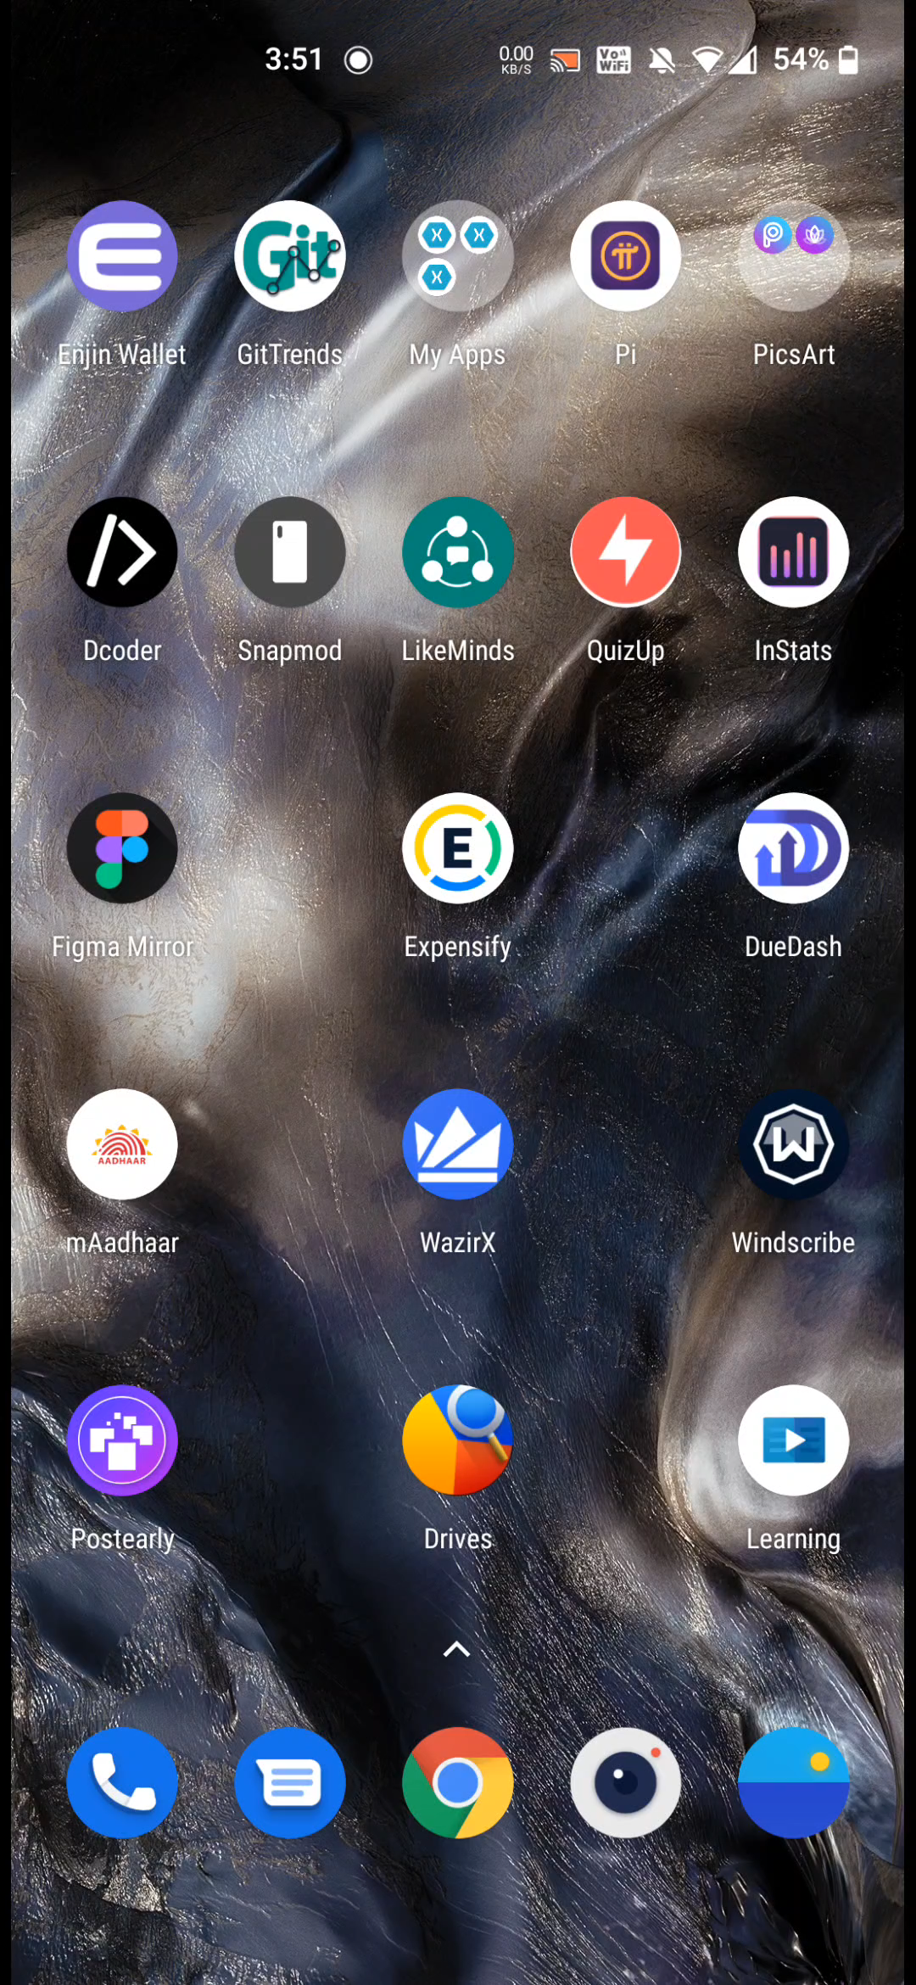
Another Fun Solution – Social Mojifier
Social Mojifier emojifies your selfie based on your predominant emotion and allows you to save and share it on your social media handles with the rest of the world!
GitHub Link: github.com/adityaoberai/SocialMojifier

Slide 16
Any Questions?

Slide 17
Thank You :)
Reach me at
Twitter: @adityaoberai1
LinkedIn: /in/adityaoberai1

